Slide 1
Assignment 1: Analysis of Bank Filings Data – Data Wrangling and Exploratory data analysis using Tableau Case Study
Under guidance of : Team 1
Prof. Sri Krishnamurthy Amulya Aankul
Ashwin Dinoriya Nand Govind Modani
Saksham Agrawal

Slide 2
Part 1: Analyzing Banks with asset values greater than $10 Billion

Slide 3
Process workflow:
Step 1 : Web Scraping using Python 3
Step 2 : Cleaning the data
Step 3 : Creating stacked and unstacked CSV file using Pandas
Step 4 : Pre-processing the data for Analysis
Step 5 : Creating Dashboards in Tableau

Slide 4
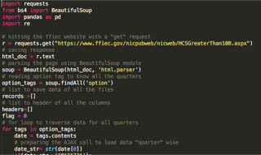
Step 1 : Web Scraping using Python 3
Modules Used :-
BeautifulSoup
To parse HTML document
Requests
To create a request and
a response to the website
Panda
To create stacked and
unstacked CSV file

Slide 5
Step 2 : Cleaning the data
Extracting the RSSD ID from the bank name
Made RSSD ID unique column so that no new row gets created if Bank Changes their name in any quarter
Sanitizing the bank name
Extracting column headers
Creating a new column for quarters
Removing the Rank column

Slide 6
Step 3 : Creating stacked and unstacked CSV file using Pandas
Creating a 2 dimensional structure for the CSV file.
Pivoting the data frame to create unstacked version of the file
File: Python code for Step 1-3

Slide 7
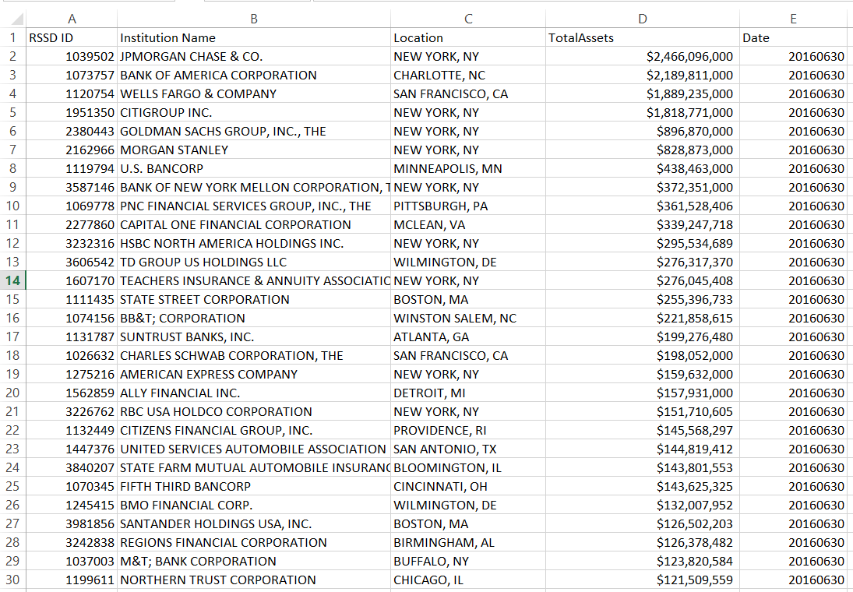
Output CSV : Stacked Version

Slide 8
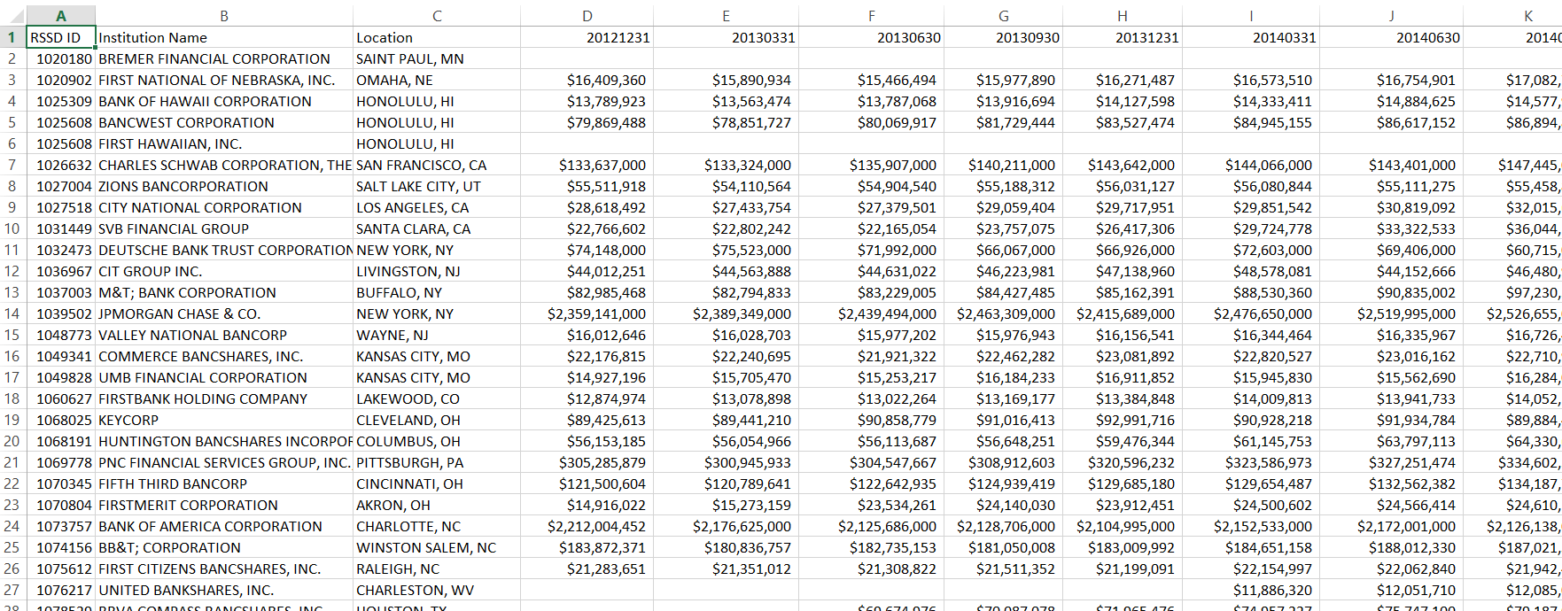
Output CSV : Unstacked Version

Slide 9
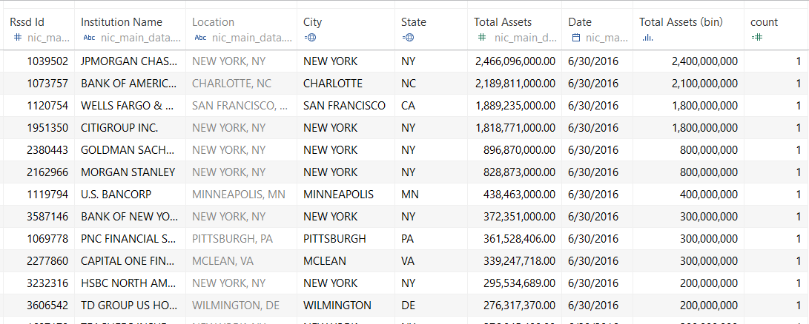
Step 4 : Pre-processing the data for Analysis
Splitting the Location into city and state for analysis purpose on Tableau

Slide 10
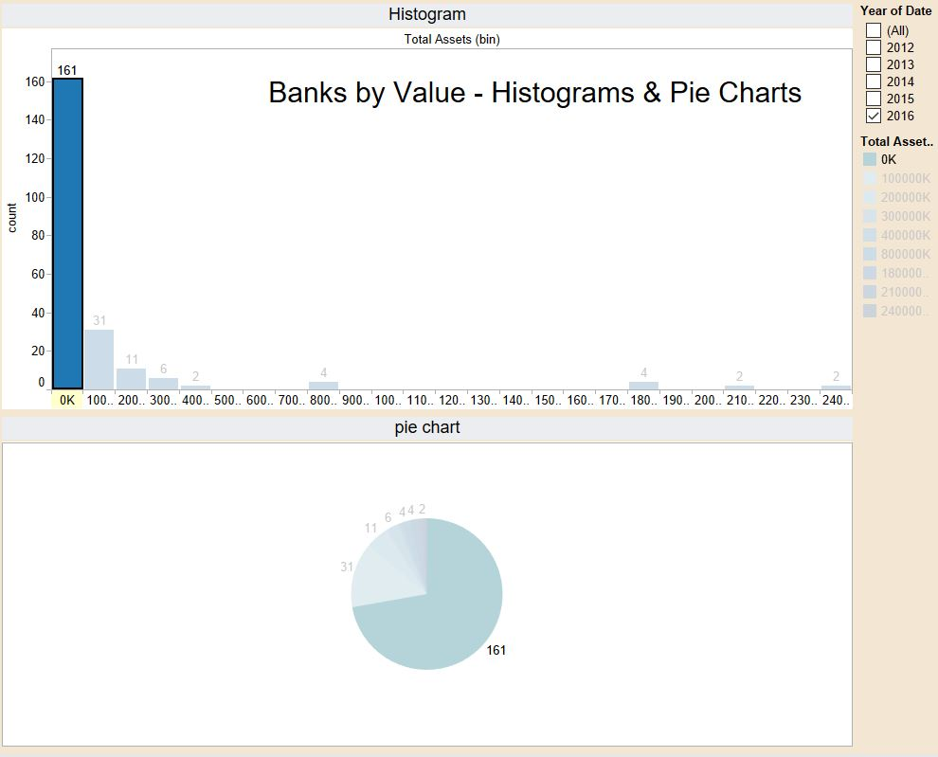
Banks by Value:
Step 5 : Creating Dashboards in Tableau
Histograms shows the count of companies in the range on the x axis.
Pie chart shows the count of companies in the range. Gives us insights about the percentage of the total value.

Slide 11
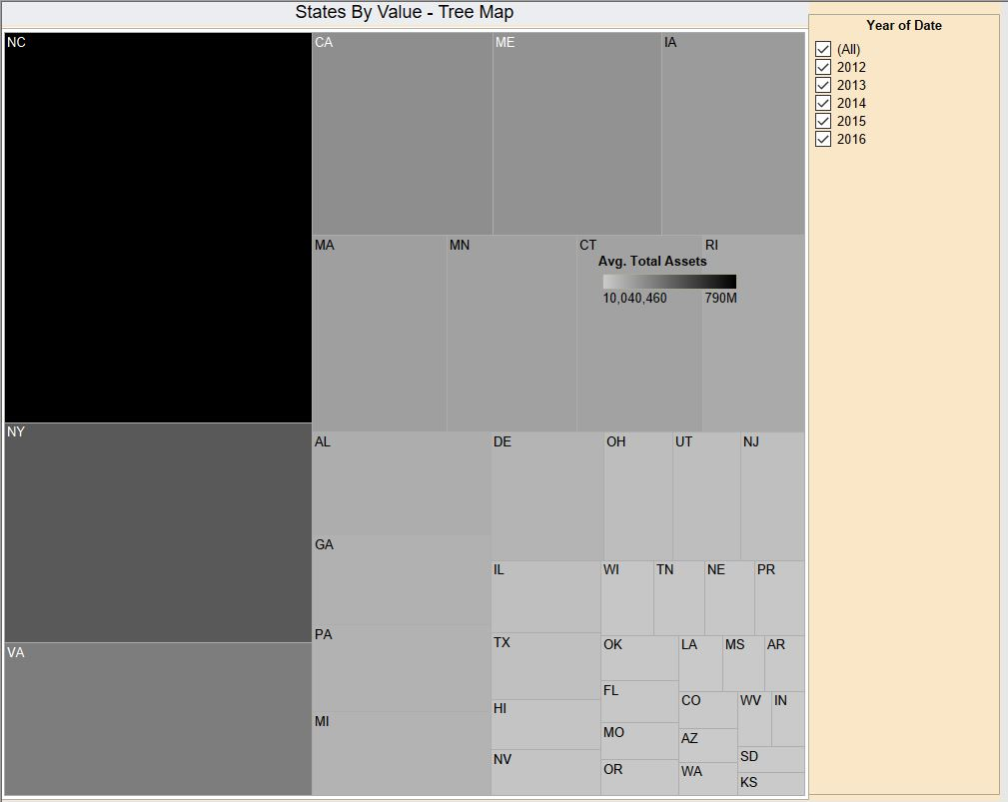
States by Value:
Tree map here shows the assets of companies grouped by the state of where they are located.
The values are filtered according to the Year. If multiple years are selected it takes the average of the values

Slide 12
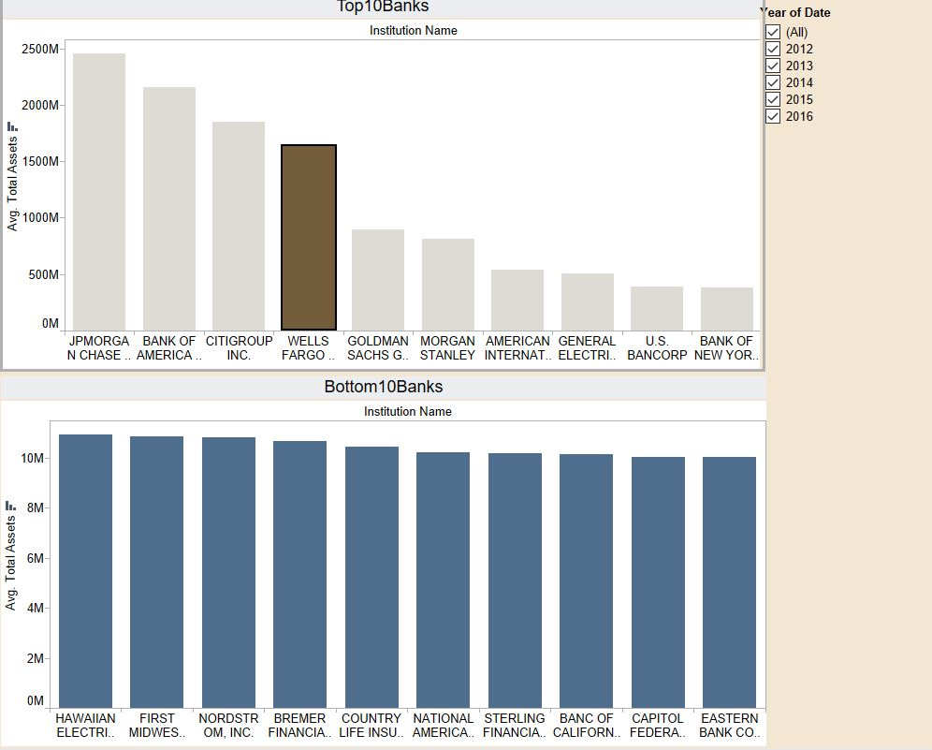
Top and Bottom 10 banks:
The bar chart shows the top 10 and bottom 10 banks by value of their assets
The values are filtered according to the Year. If multiple years are selected it takes the average of the values

Slide 13
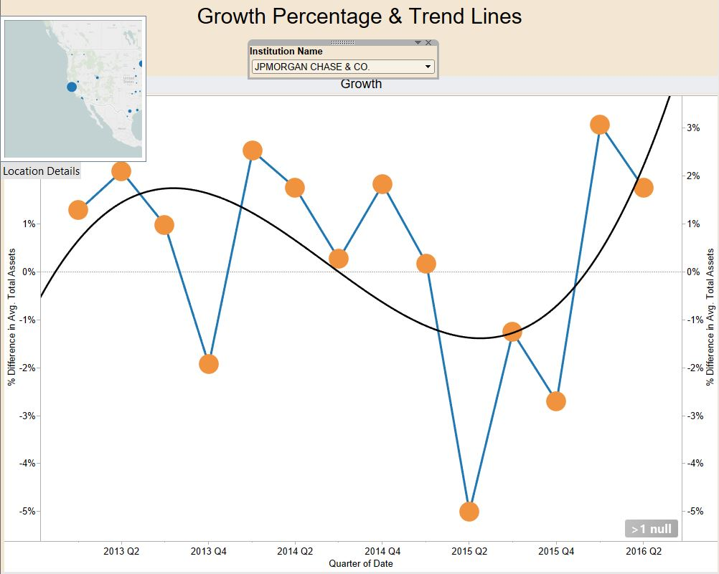
Growth Percentage:
Shows the percentage growth of assets & trend lines with respect to successive quarters
The figure shows the trend line for JP Morgan, which shows their assets are expected to increase in the next quarter.

Slide 14
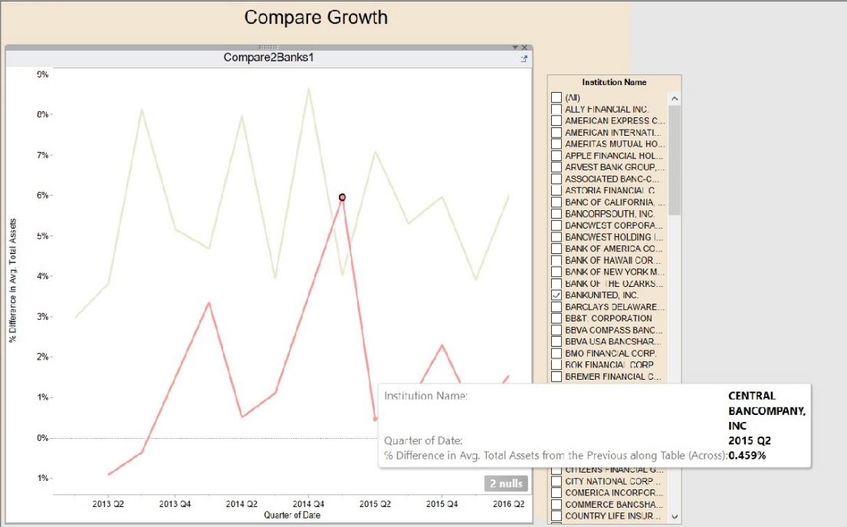
Growth comparison:
The graph compares the asset growth of companies selected for every quarter.
The figure shows that % asset growth of Central bankcompany Inc. is generally lower than Bankunited Inc

Slide 15
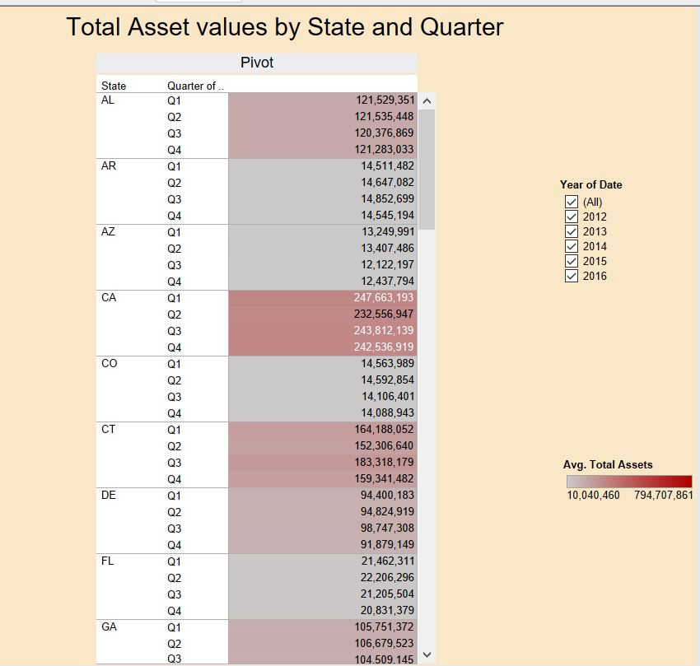
Total Asset value:
The figure shows total asset values grouped by the states for every quarter.

Slide 16
Part 2: Data Scraping for BHCPR Average Reports

Slide 17
Process workflow:
Step 1 : Scrape WebPage to get all the reqd. PDF files (Peer 1)
Step 2 : Scraping the PDF file
Step 3 : Cleaning the data
Step 4 : Creating and saving the data into CSV file
Step 5 : Repeating Step 2-4 for all Peer 1 files
Note : Used Python2.7

Slide 18
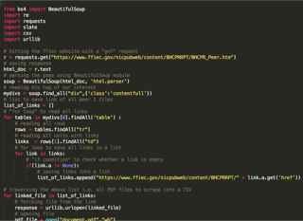
Step 1 : Scrape WebPage to get all the PDFs
Modules used:
Beautiful Soup
To parse HTML document
Requests
To create a request and
a response to the website
Slate
To scrape PDFs
Urllib
Fetch file from HTTPResponse

Slide 19
Step 2 : Scraping the PDF file
Used “slate 0.5.2” package for scraping all PDFs.
“slate” is a wrapper package for PDFMiner
Fetched all PDF file links using “urllib” library

Slide 20
Step 3 : Cleaning the Data
Identified the rows & columns by recognizing the pattern of formatting in the PDF file
Created a list of lists containing the data of PDF file
Removed all the white spaces
Removed all redundant lines
Aligned the headers & data in respective positions

Slide 21
Step 4 : Creating and saving the data into CSV
Created File name as reqd. by extracting it from the online PDF file itself i.e. from https://www.ffiec.gov/nicpubweb/content/BHCPRRPT/REPORTS/BHCPR_PEER/June2016/PeerGroup_1_June2016.pdf
to “Peer1_2016_June.csv”
Using “csv” module, made a CSV file for each quarter

Slide 22
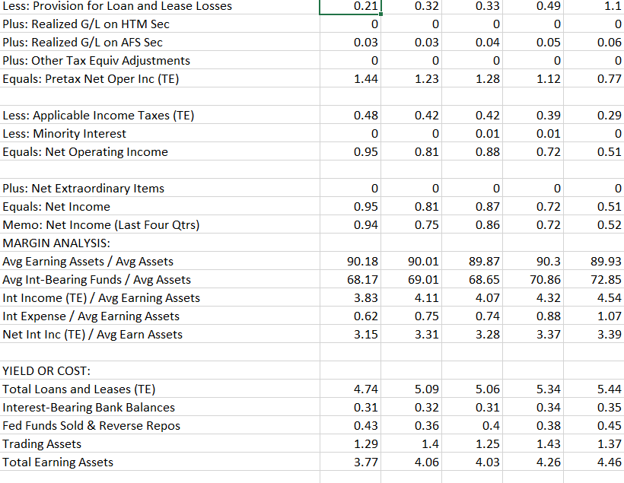
Output CSV

Slide 23
Step 5 : Repeating Step 2-4 for all Peer 1 files
Traverse through the list of links of PDF files fetched in Step 1
For every PDF file, scrape, clean & save a new CSV
File: Python code for Part 2

Slide 24
Part 3: Analysis of Banking Organization Systemic Risk Reports for the years 2012, 2013 and 2014

Slide 25
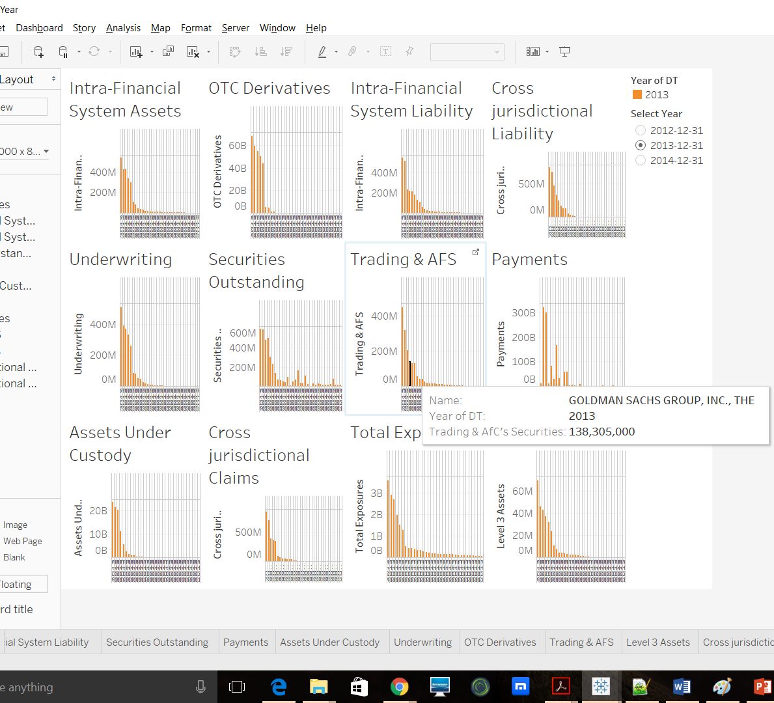
Graphs Dashboard
12 bar charts for Measures for each Bank.
Filtering based on Year.

Slide 26
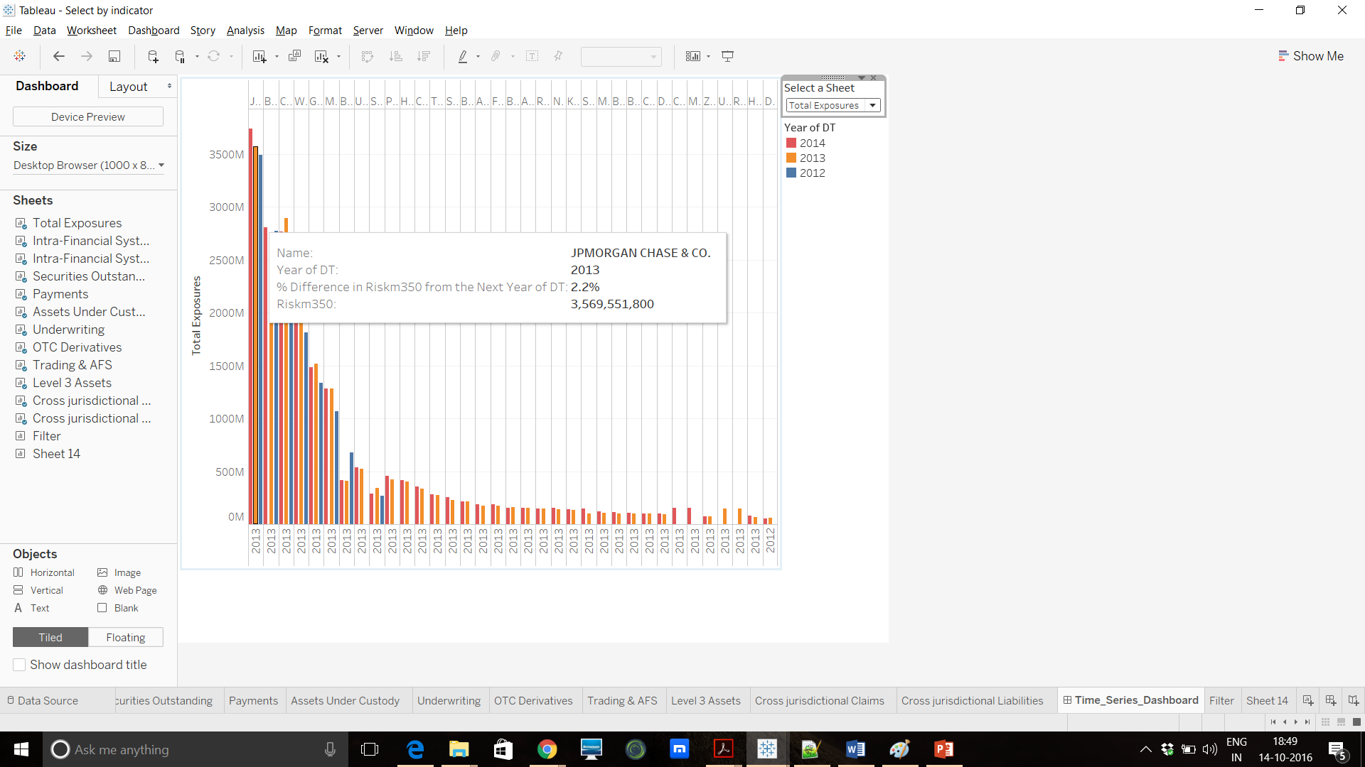
Time Series Dashboard
Shows Year to Year comparison in form of Percentage Change values.
Sheet Selector as Dashboard filter, to select Measure value over the 3 years.

Slide 27
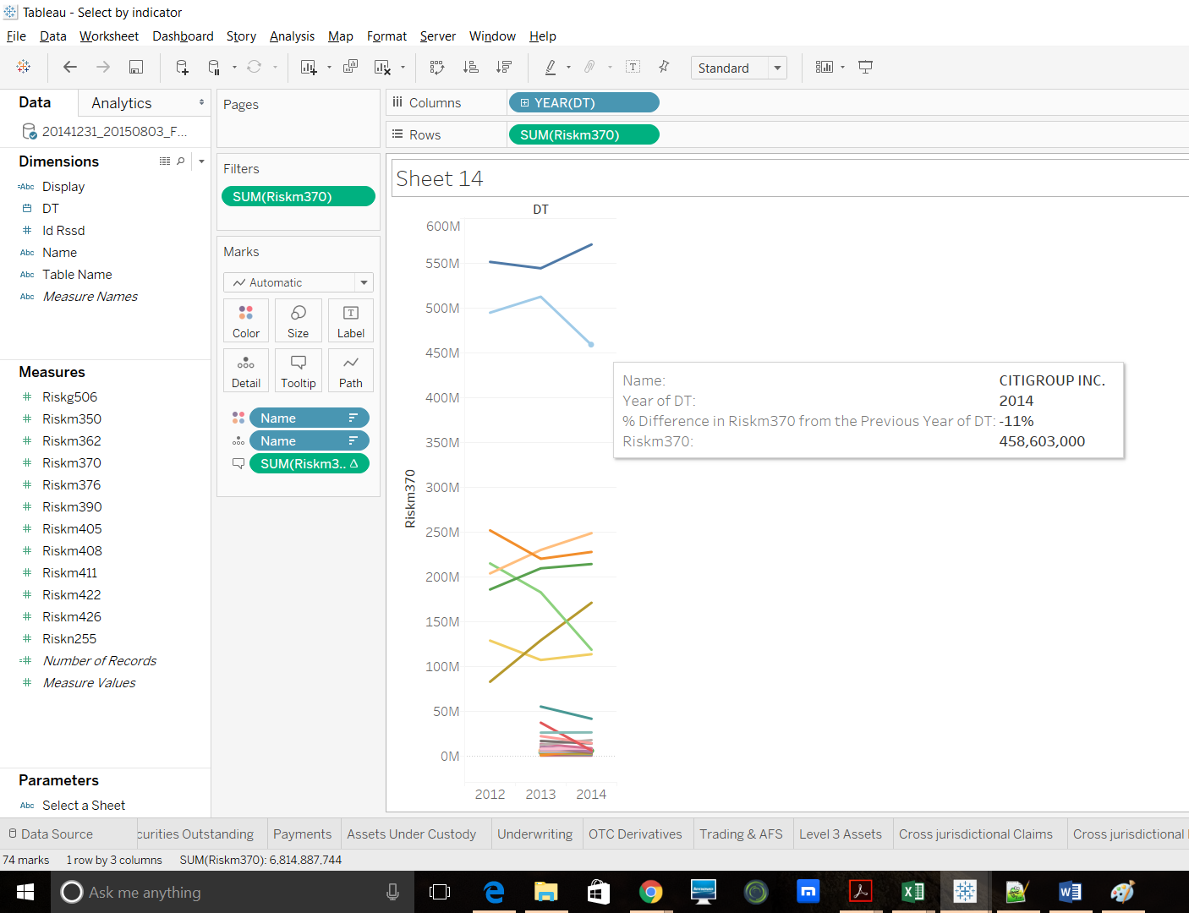
Alternative Visualization techniques
Line Graph
Progressive visual of a measure for each bank over the years.
Tooltip Indicates percentage change.
Indicates the rise & fall of a measure for each bank.

Slide 28
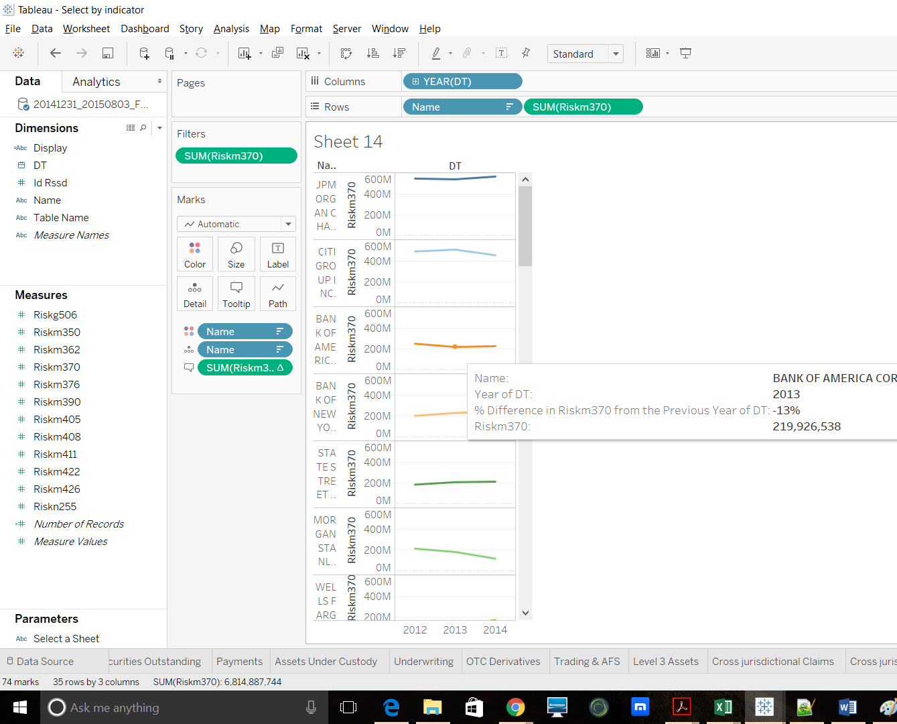
Contd..

Slide 29
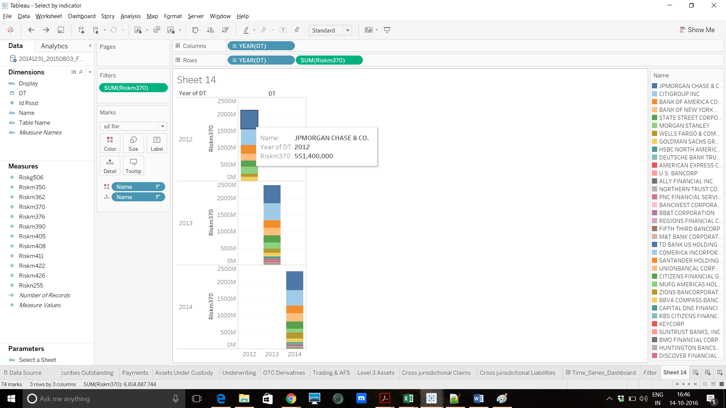
Contd..

Slide 30
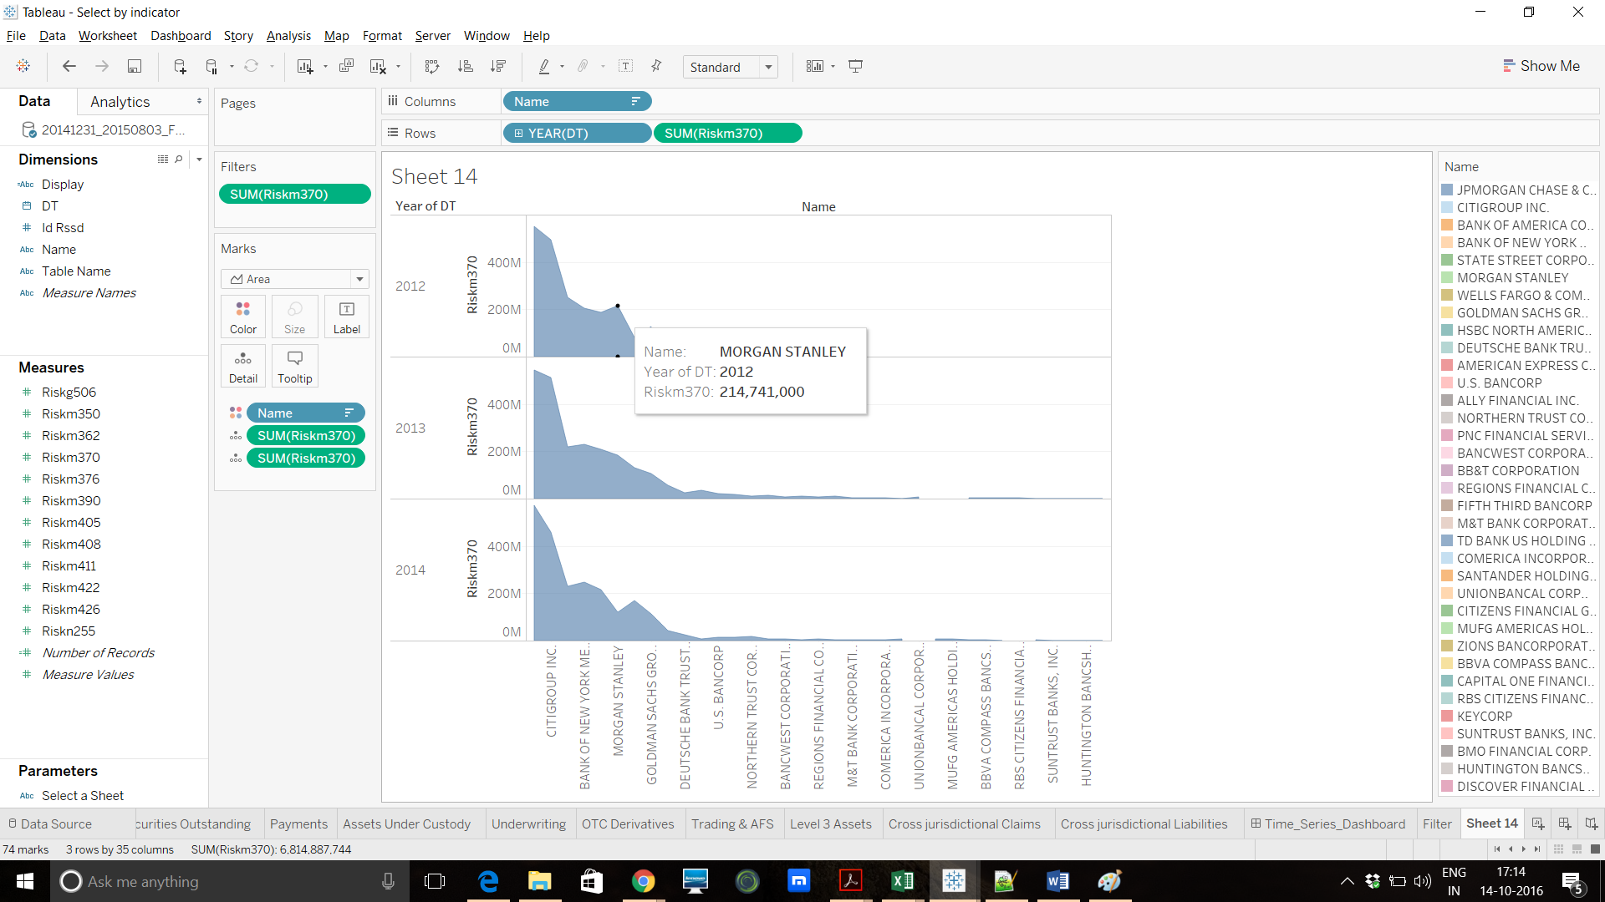
Contd..

Slide 31
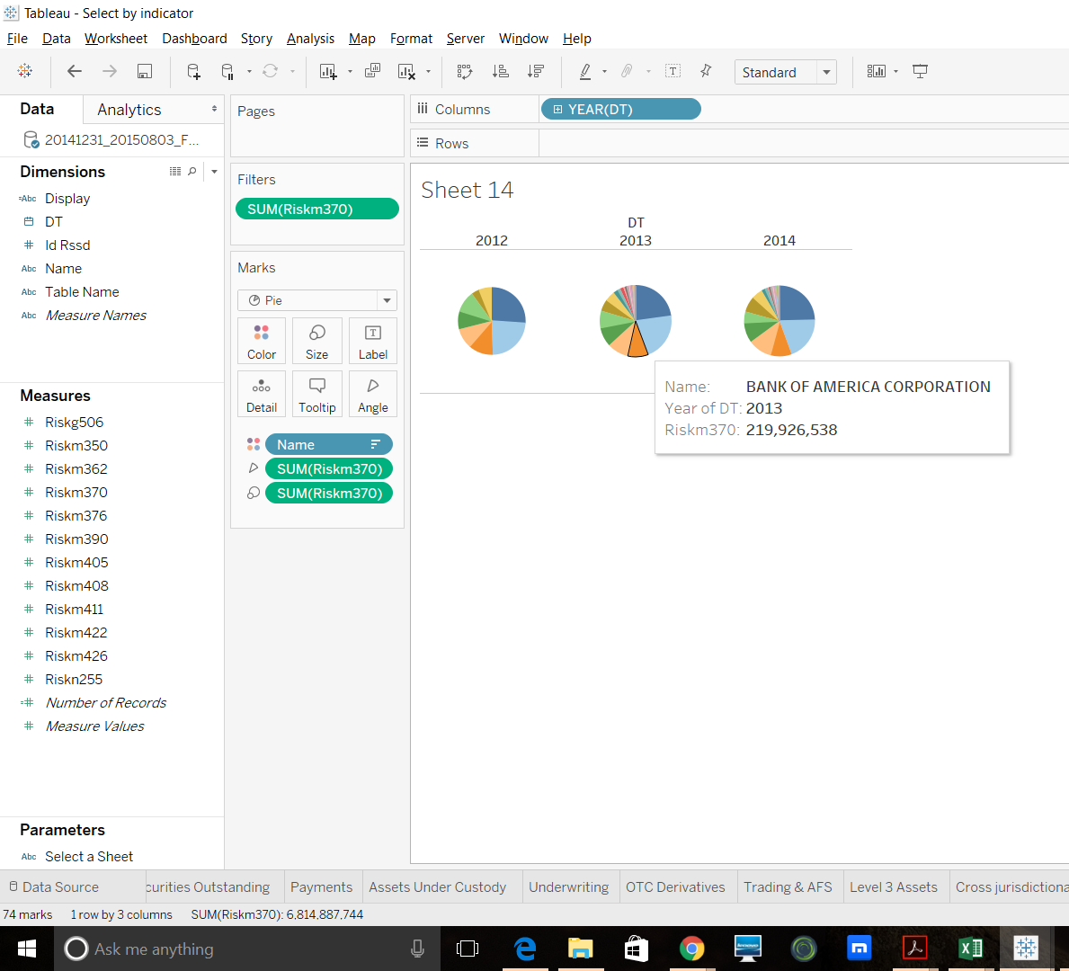
Pie Chart
Year Wise Distribution of individual measure for all the banks.
Chart shows data for all the banks & its measure distribution for each year.

Slide 32
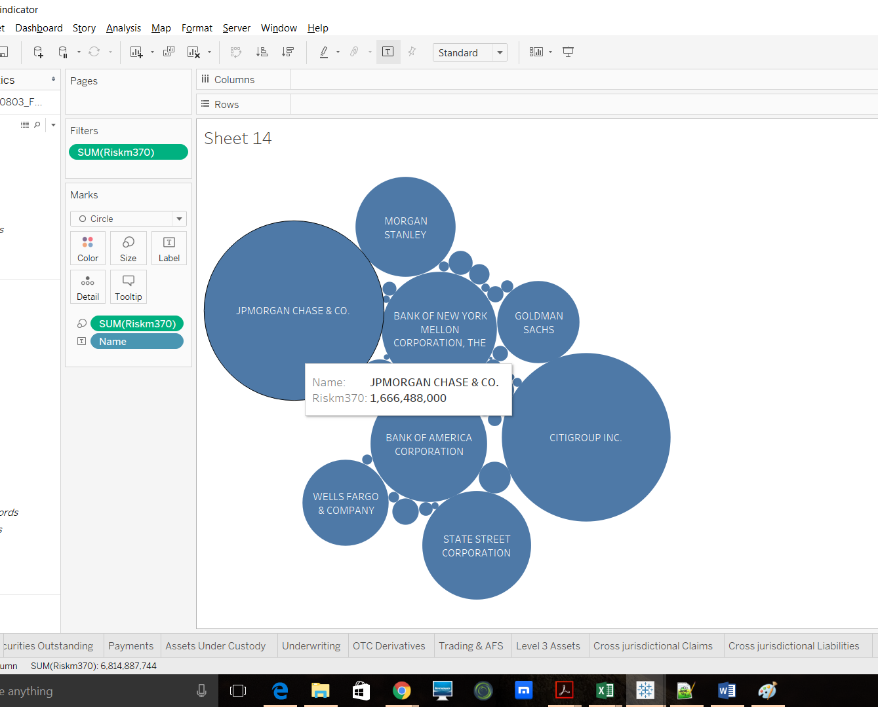
Packed Bubbles
Total Bank Distribution of a measure value computed for all years.
Combined Distribution for all banks for all the years for an individual measure.

Slide 33
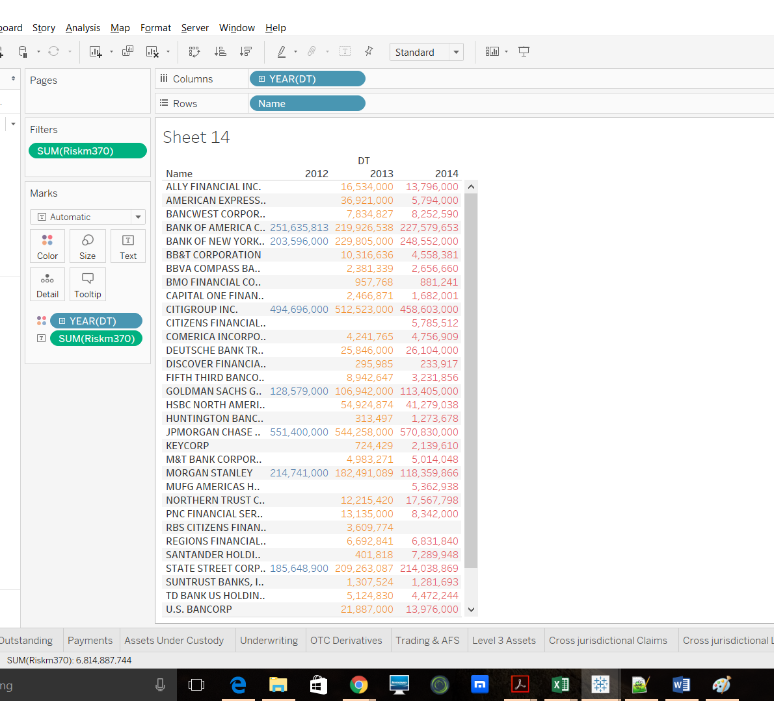
Text Tables/Highlight Tables
Tabular data for bank assets over 3 years.

Slide 34
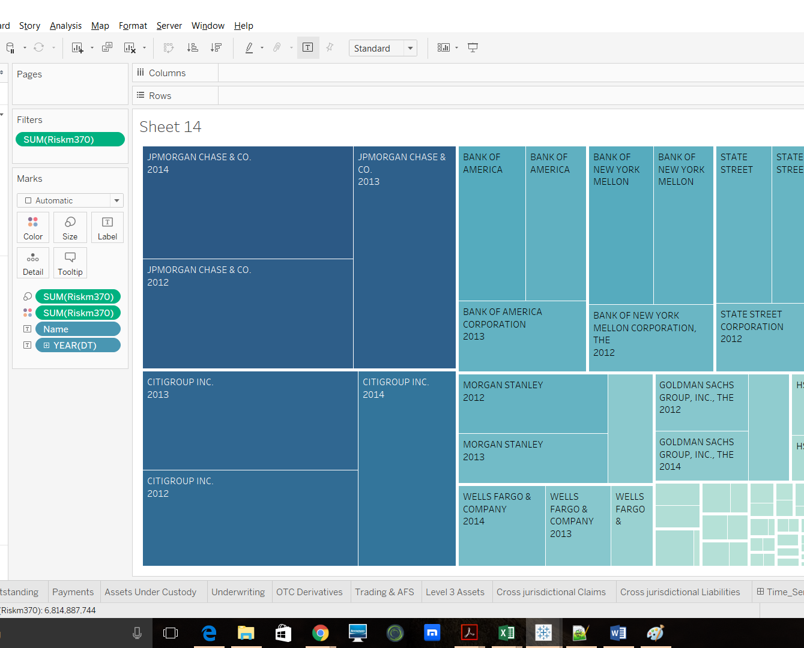
Tree Maps
Year wise measure distribution for banks.
Coloring the rectangles by measure value

Slide 35
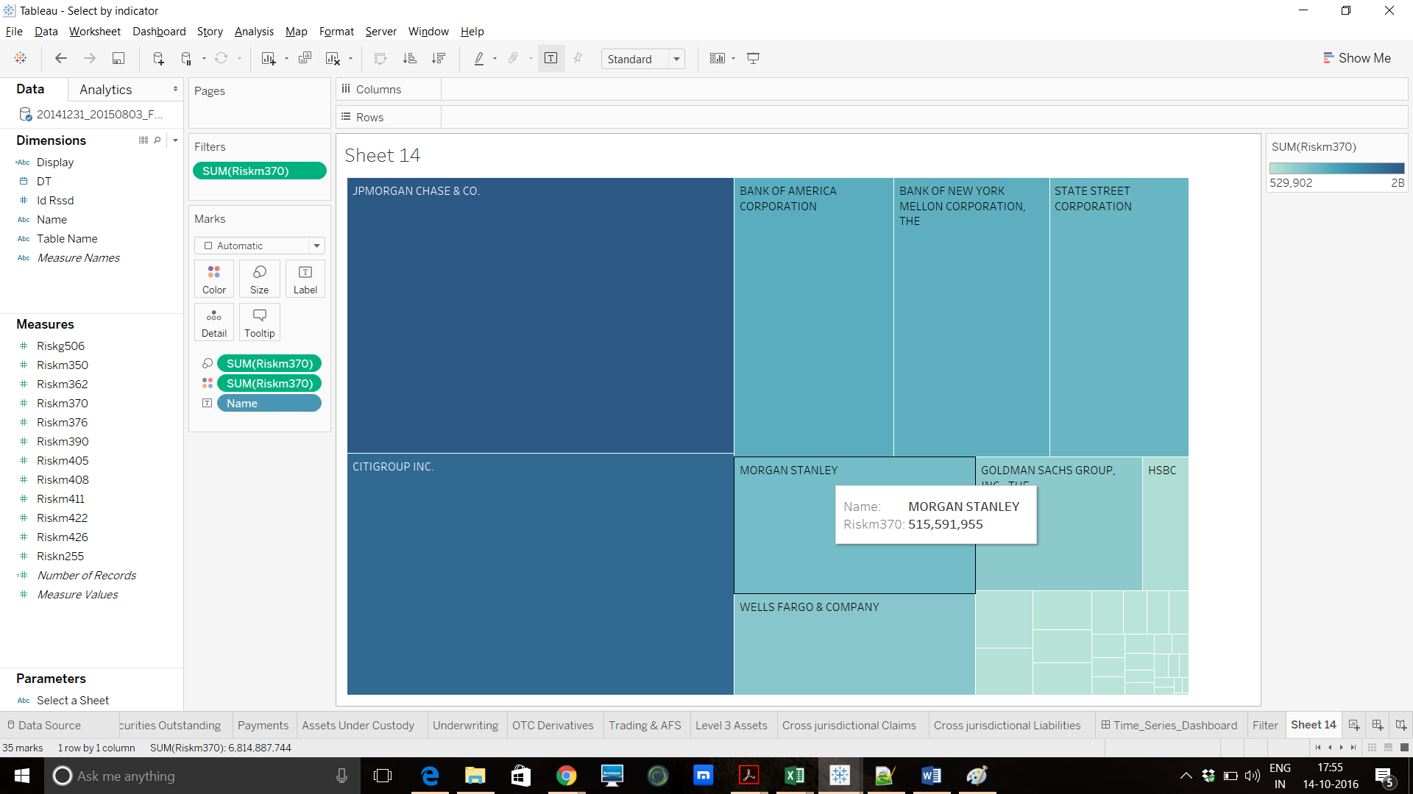
Contd..

Slide 36
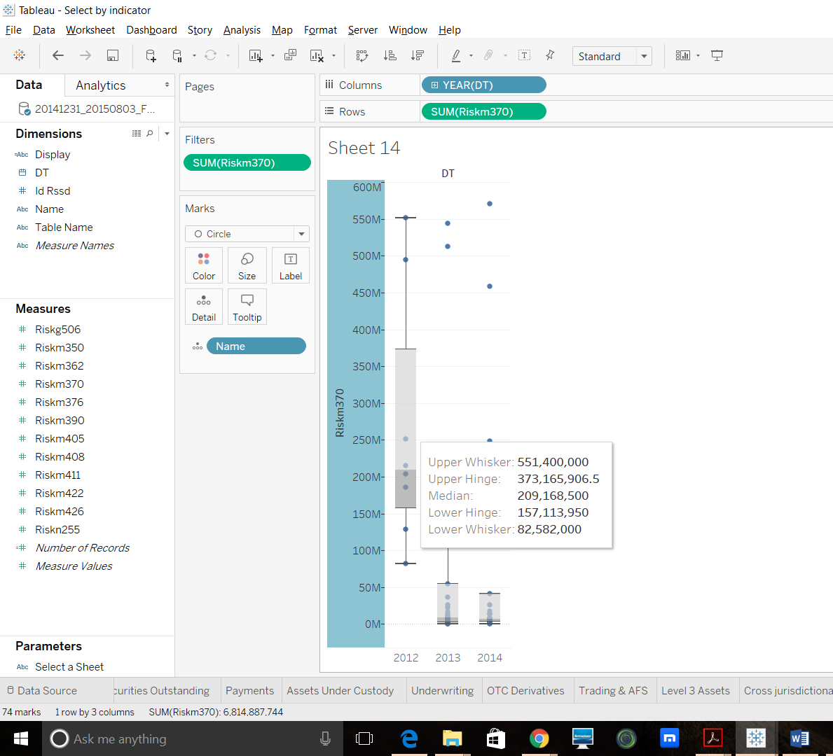
Box Plots
Shows Median of the measure value along with 1st & 3rd Quartiles.
Shows the skewness of data.
Shows details about the outliers

Slide 37
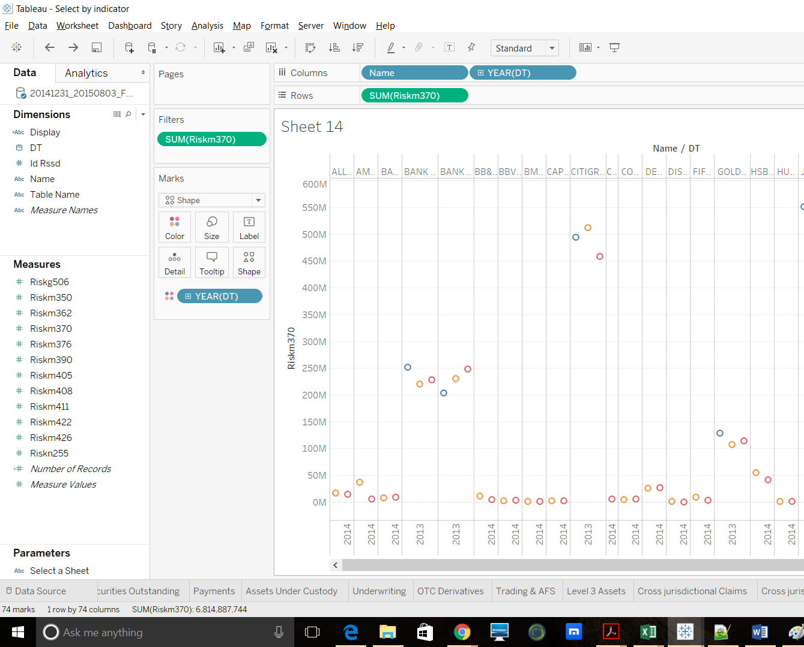
Side-by-Side Circle Views
Technique to accentuate data on scatter plots.
Tells about relative concentration of data.

Slide 38
Thank you!

